Slide 1
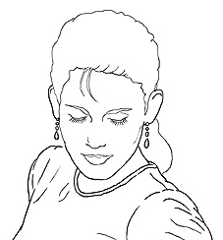
Edge detection
Goal: Identify sudden changes (discontinuities) in an image
  Intuitively, most semantic and shape information from the image can be encoded in the edges
  More compact than pixels
Ideal: artist’s line drawing (but artist is also using object-level knowledge)
Source: D. Lowe

Slide 2
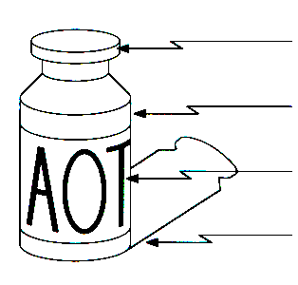
Origin of edges
Edges are caused by a variety of factors:
surface normal discontinuity
depth discontinuity
surface color discontinuity
illumination discontinuity
Source: Steve Seitz

Slide 3

Characterizing edges
An edge is a place of rapid change in the image intensity function
intensity function
(along horizontal scanline)
image
first derivative
edges correspond to
extrema of derivative

Slide 4
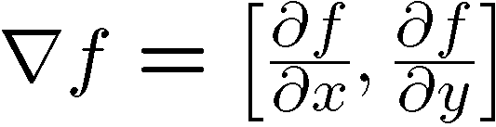
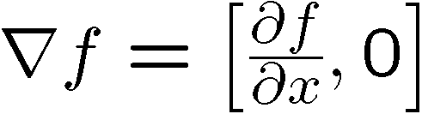

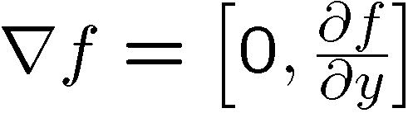
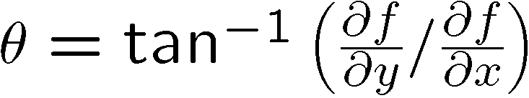
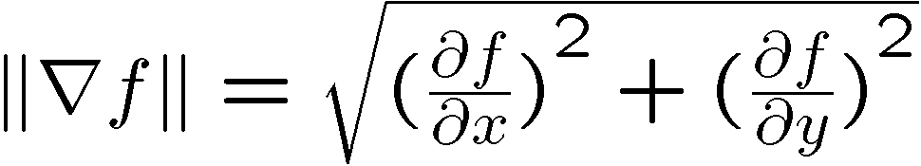
Image gradient
The gradient of an image:
The gradient points in the direction of most rapid increase in intensity
How does this direction relate to the direction of the edge?
The gradient direction is given by
The edge strength is given by the gradient magnitude
Source: Steve Seitz
Notes:
give definition of partial derivative: lim h->0 [f(x+h,y) – f(x,y)]/h

Slide 5
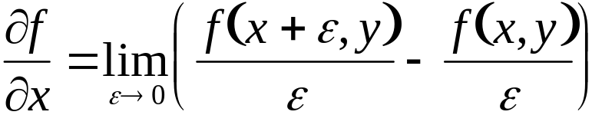
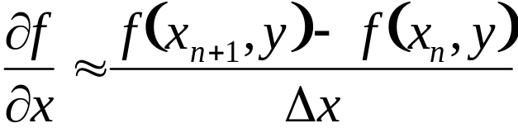
Differentiation and convolution
Recall, for 2D function, f(x,y):
This is linear and shift invariant, so must be the result of a convolution.
We could approximate this as
(which is obviously a convolution)
-1 | 1
Source: D. Forsyth, D. Lowe

Slide 6
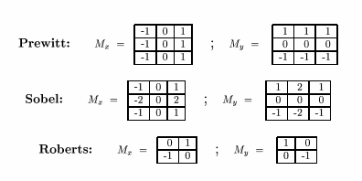
Finite difference filters
Other approximations of derivative filters exist:
Source: K. Grauman

Slide 7
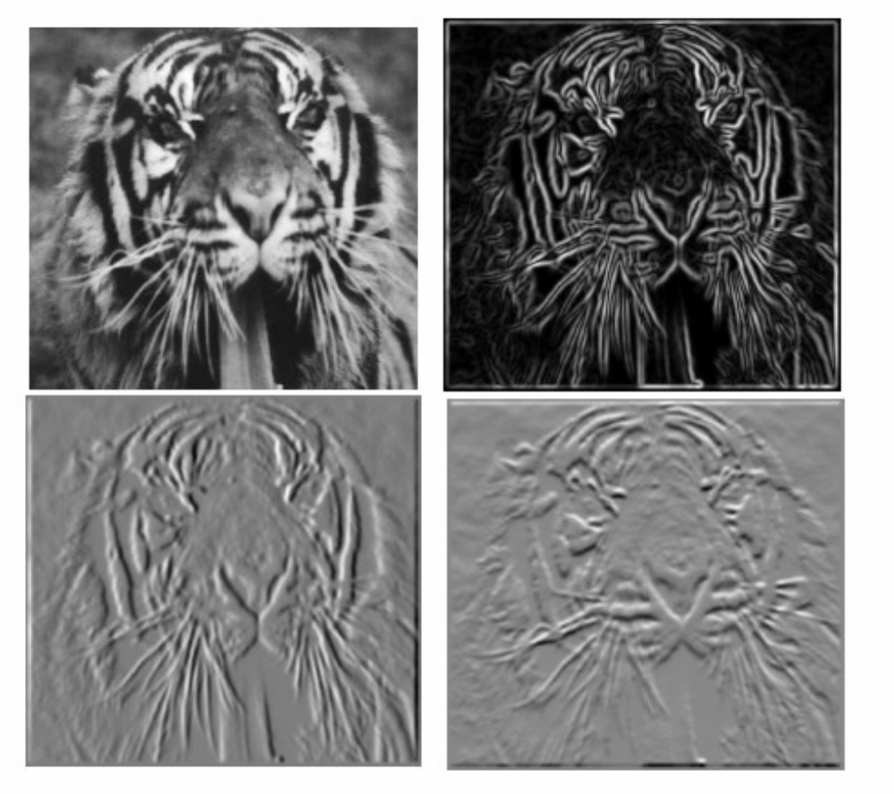
Finite differences: example
Which one is the gradient in the x-direction (resp. y-direction)?

Slide 8
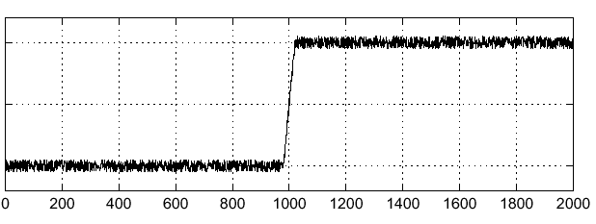

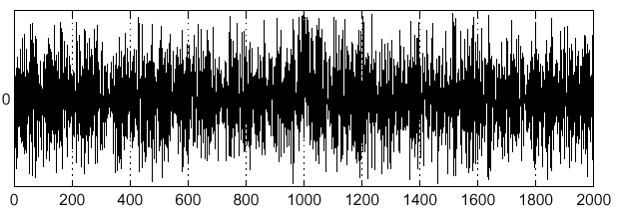
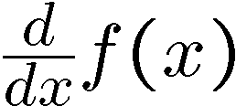
Effects of noise
Consider a single row or column of the image
  Plotting intensity as a function of position gives a signal
Where is the edge?
Source: S. Seitz
Notes:
How to fix?

Slide 9
Effects of noise
Finite difference filters respond strongly to noise
  Image noise results in pixels that look very different from their neighbors
  Generally, the larger the noise the stronger the response
What is to be done?
  Smoothing the image should help, by forcing pixels different from their neighbors (=noise pixels?) to look more like neighbors
Source: D. Forsyth

Slide 10
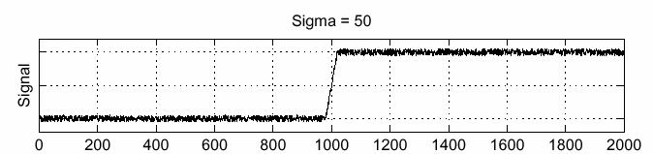
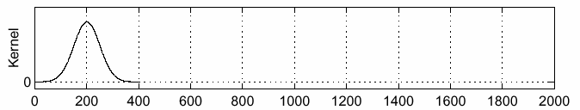
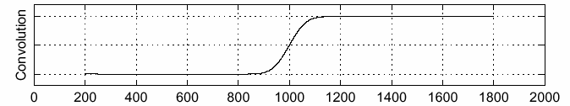
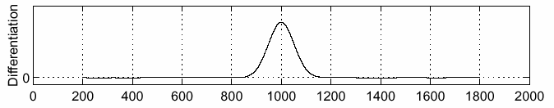
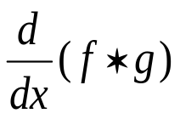

Solution: smooth first
f
g
f * g
To find edges, look for peaks in
Source: S. Seitz

Slide 11
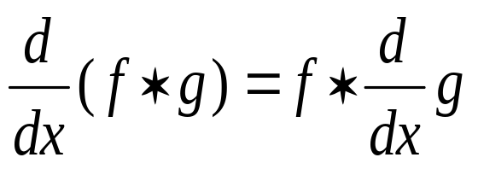
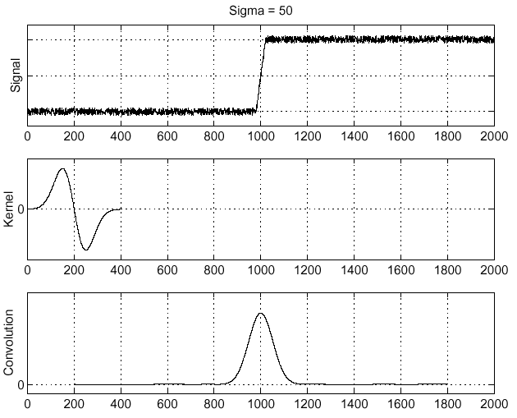
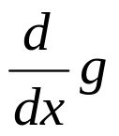
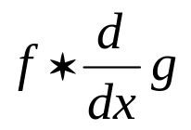
Derivative theorem of convolution
Differentiation is convolution, and convolution is associative:
This saves us one operation:
f
Source: S. Seitz

Slide 12
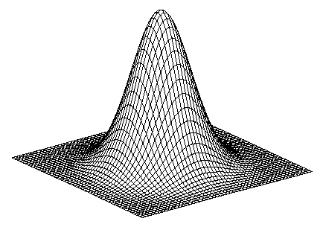
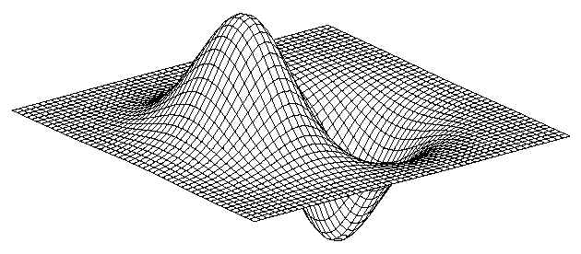
Derivative of Gaussian filter
* [1 -1] =
Is this filter separable?

Slide 13
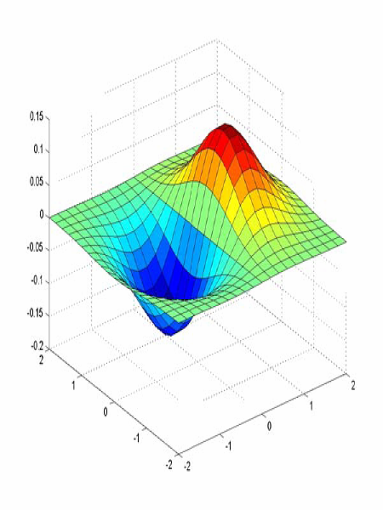
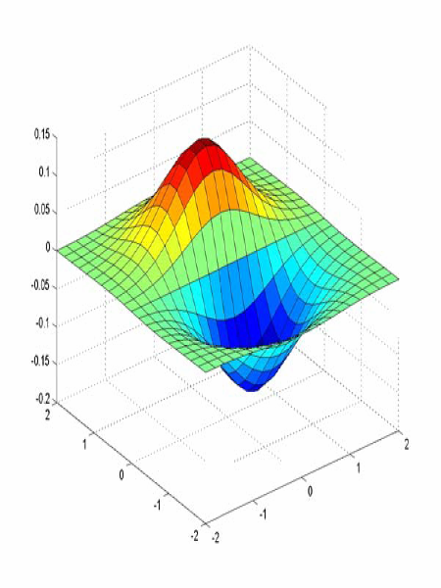
Derivative of Gaussian filter
x-direction
y-direction
Which one finds horizontal/vertical edges?

Slide 14
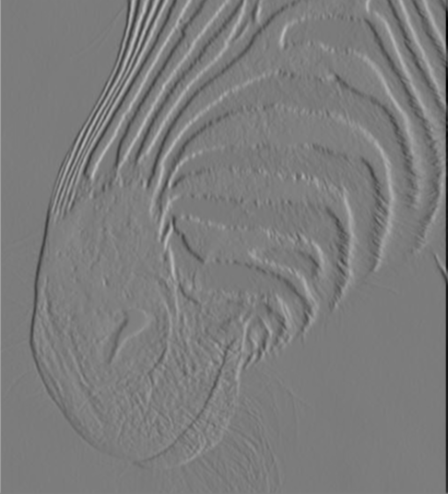
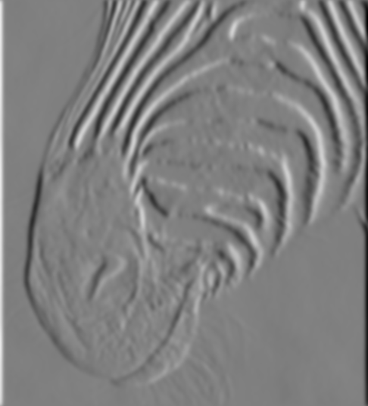
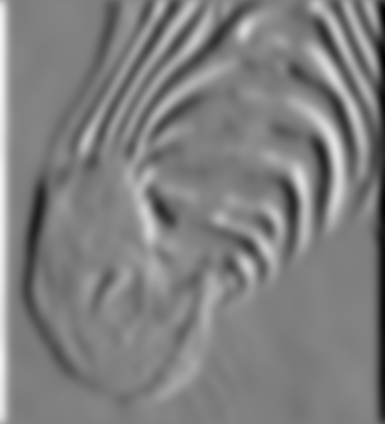
Scale of Gaussian derivative filter
1 pixel
3 pixels
7 pixels
Smoothed derivative removes noise, but blurs edge. Also finds edges at different “scales”.
Source: D. Forsyth

Slide 15
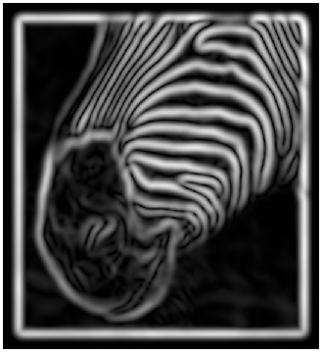
Implementation issues
The gradient magnitude is large along a thick “trail” or “ridge,” so how do we identify the actual edge points?
How do we link the edge points to form curves?
Source: D. Forsyth
Notes:
Figures show gradient magnitude of zebra at two different scales

Slide 16
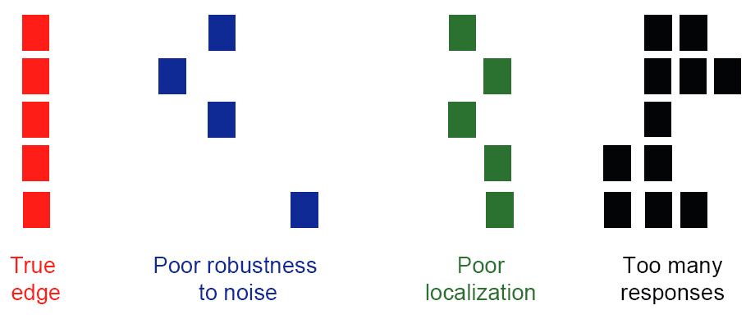
Designing an edge detector
Criteria for an “optimal” edge detector:
  Good detection: the optimal detector must minimize the probability of false positives (detecting spurious edges caused by noise), as well as that of false negatives (missing real edges)
  Good localization: the edges detected must be as close as possible to the true edges
  Single response: the detector must return one point only for each true edge point; that is, minimize the number of local maxima around the true edge
Source: L. Fei-Fei

Slide 17
Canny edge detector
This is probably the most widely used edge detector in computer vision
Theoretical model: step-edges corrupted by additive Gaussian noise
Canny has shown that the first derivative of the Gaussian closely approximates the operator that optimizes the product of signal-to-noise ratio and localization
MATLAB: edge(image, ‘canny’)
J. Canny, A Computational Approach To Edge Detection, IEEE Trans. Pattern Analysis and Machine Intelligence, 8:679-714, 1986.
Source: L. Fei-Fei

Slide 18
Canny edge detector
Filter image with derivative of Gaussian
Find magnitude and orientation of gradient
Non-maximum suppression:
  Thin multi-pixel wide “ridges” down to single pixel width
Source: D. Lowe, L. Fei-Fei

Slide 19


Non-maximum suppression
At q, we have a maximum if the value is larger than those at both p and at r. Interpolate to get these values.
Source: D. Forsyth

Slide 20

Example
original image (Lena)

Slide 21
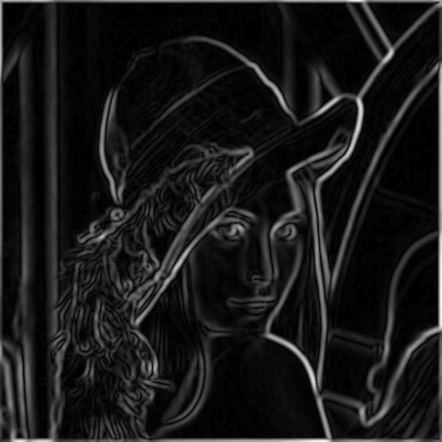
Example
norm of the gradient

Slide 22
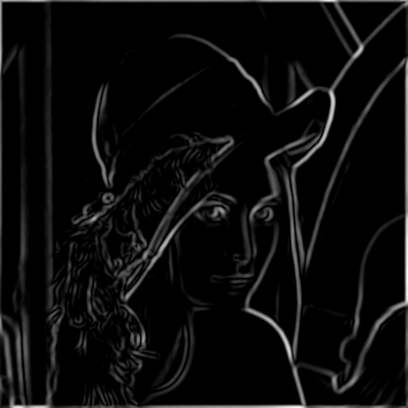
Example
thresholding

Slide 23
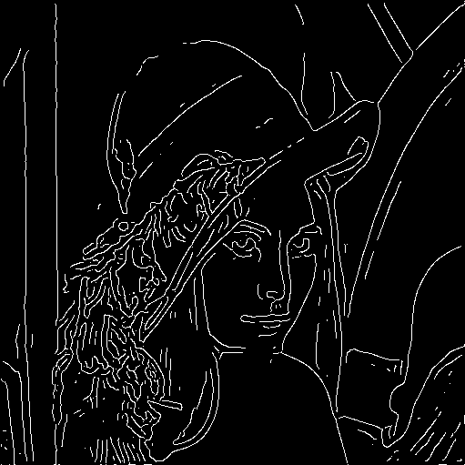
Example
Non-maximum suppression

Slide 24
Canny edge detector
Filter image with derivative of Gaussian
Find magnitude and orientation of gradient
Non-maximum suppression
  Thin multi-pixel wide “ridges” down to single pixel width
Linking of edge points
Source: D. Lowe, L. Fei-Fei

Slide 25
Edge linking
Assume the marked point is an edge point. Then we construct the tangent to the edge curve (which is normal to the gradient at that point) and use this to predict the next points (here either r or s).
Source: D. Forsyth

Slide 26
Canny edge detector
Filter image with derivative of Gaussian
Find magnitude and orientation of gradient
Non-maximum suppression
  Thin multi-pixel wide “ridges” down to single pixel width
Linking of edge points
  Hysteresis thresholding: use a higher threshold to start edge curves and a lower threshold to continue them
Source: D. Lowe, L. Fei-Fei

Slide 27
Hysteresis thresholding
Use a high threshold to start edge curves and a low threshold to continue them
  Reduces drop-outs
Source: S. Seitz

Slide 28
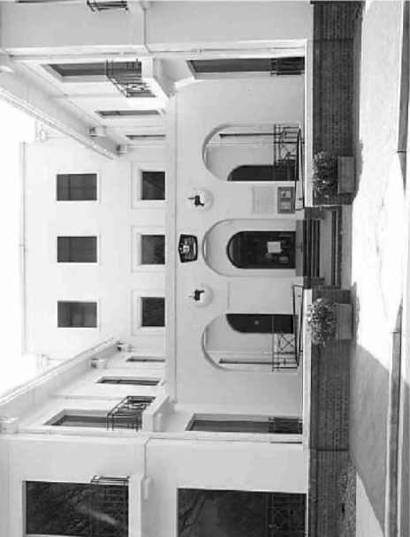
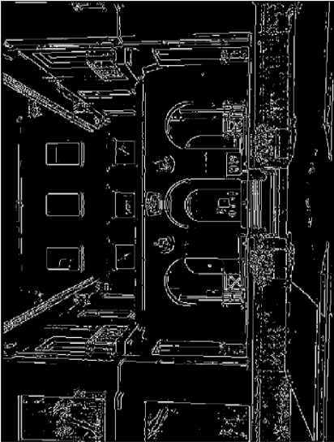
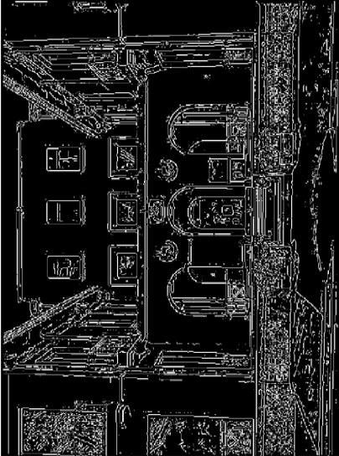
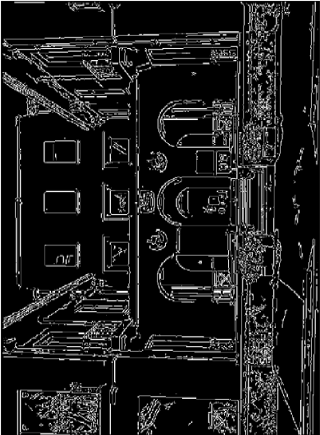
Hysteresis thresholding
original image
high threshold
(strong edges)
low threshold
(weak edges)
hysteresis threshold
Source: L. Fei-Fei

Slide 29





Effect of σ (Gaussian kernel spread/size)
original
Canny with
Canny with
The choice of σ depends on desired behavior
  large σ detects large scale edges
  small σ detects fine features
Source: S. Seitz

Slide 30
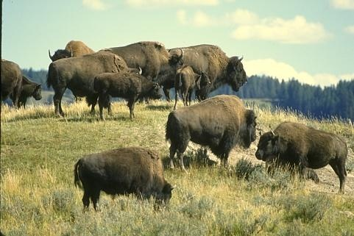
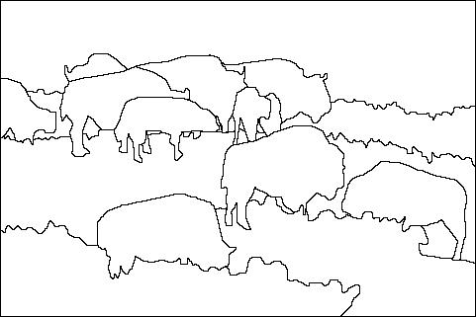
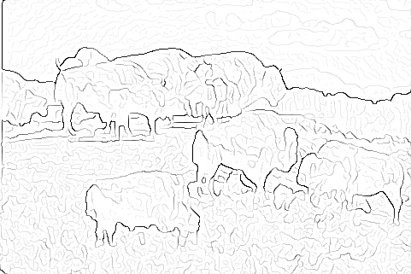

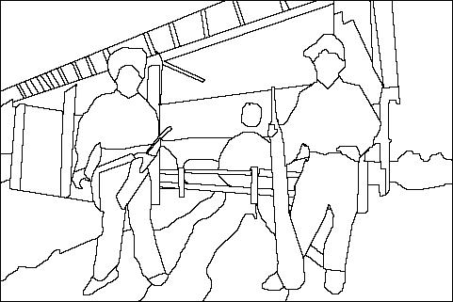
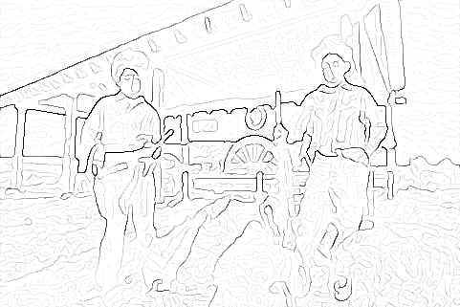
Edge detection is just the beginning…
image
human segmentation
gradient magnitude
Berkeley segmentation database:
http://www.eecs.berkeley.edu/Research/Projects/CS/vision/grouping/segbench/

